Slide 1
Logic Driven Physics
Resurrecting an ancient project
Leading to the Periodic Table of elementary particles
Based upon a Geometric Algebra without number or coordinates.
Expressed in a four letter Logical Calculus.
Inspiration: Leibniz’s project, Stoic logic

Slide 2
Periodic Table – a glimpse
http://www.theotherscience.com/StoicSide/default.aspx

Slide 3
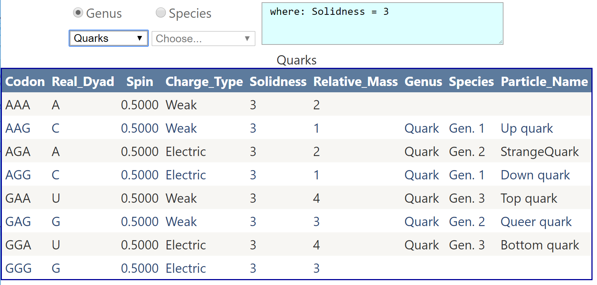
SQL database queries

Slide 4
Reconstruction of Stoic Natural Philosophy
Stoic “nowness” paradigm
Things in the past do not exist.
Things in the future do not exist
Only things in the present exist.
First Classness Principle
There are no distinguished entities
No object/property dichotomy.
Properties are objects in there own right.
Second Order Abstraction (A2)
Eliminate the placeholder/value dichotomy
Dirac Notation
Diachronic
< x | Ψ >
Synchronic
< x ↑ Ψ >
Stoic pneuma

Slide 5
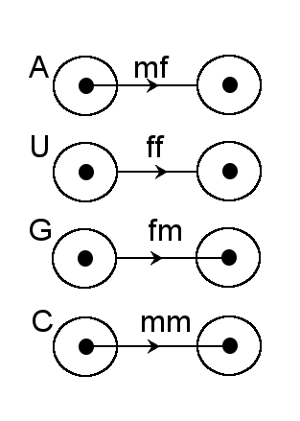
Rapid overview of theory applied to subatomic particles
There is another layer
All sub-atomic elements are composed of
triads of sub-quarks
The Four Sub-Quarks
Each sub-quark can be illustrated with a corresponding Heraclitus diagram

Slide 6
Sub-Quark Algebra – oriented numbers
A dyad is time-like
A ⇒ j where j² = 1
U dyad is light-like
It is orthogonal to itself thus
U ⇒ k where k² = 0
G dyad is space-like
G ⇒ i where i² = -1 and i ⊥ j
C dyad is singular . It is orthogonal to any line present, including itself. Thus
C ⇒ r where ∀x r ⊥ x
r is the null vector of undetermined orientation

Slide 7
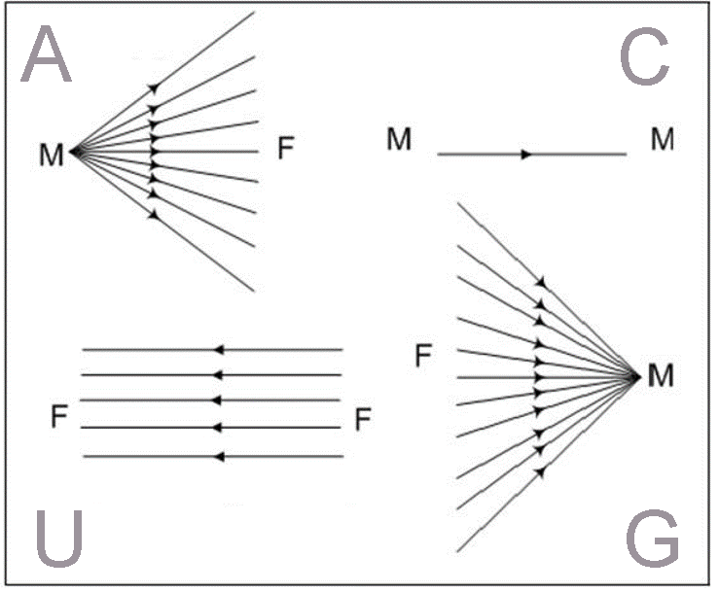
Cones and bundles

Slide 8
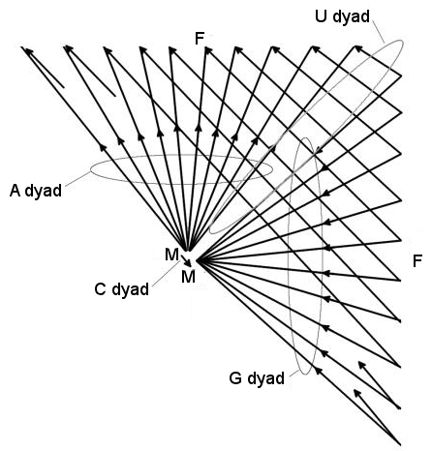
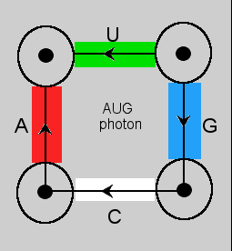
Sub-Quark Geometry
“Start Codon” AUG

Slide 9
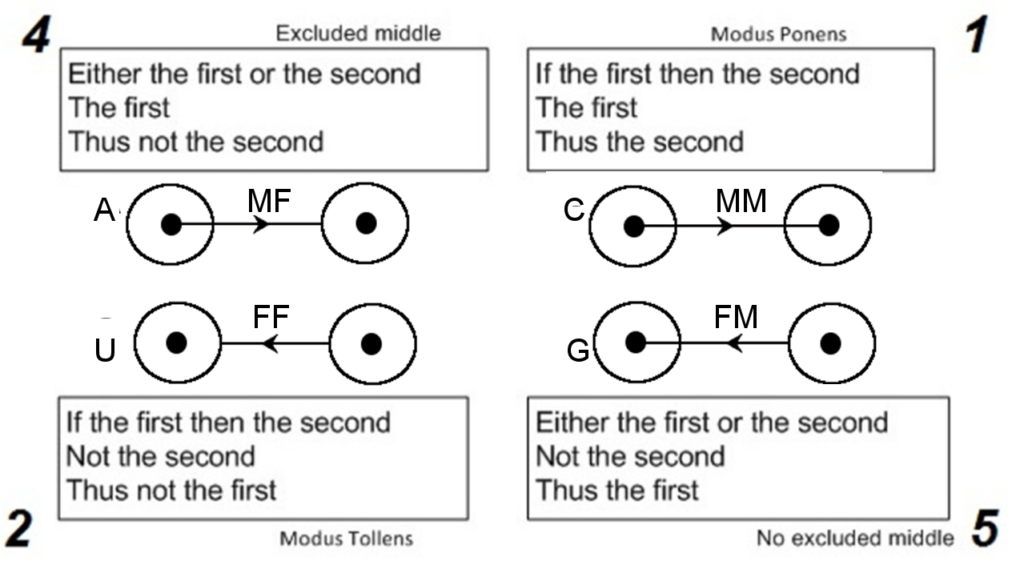
Stoic Five indemonstrables

Slide 10
The Four Forces
A Weak force
U Gravitation
G Electric force
C Strong force

Slide 11
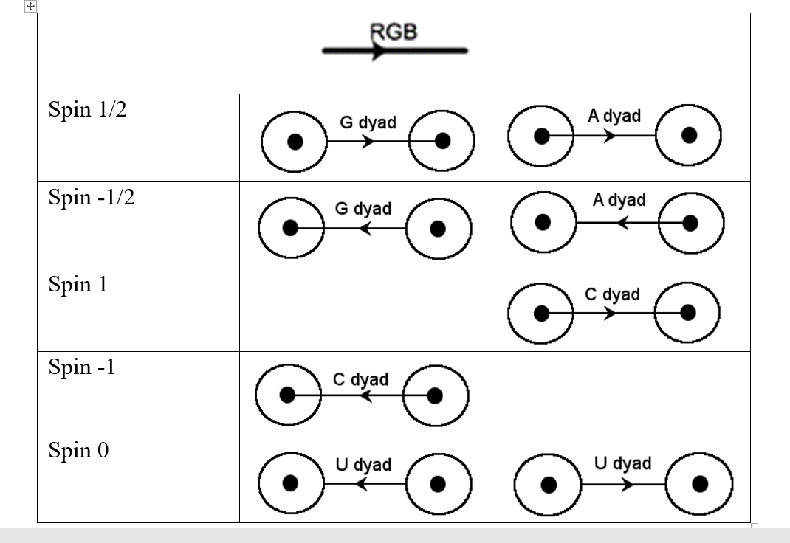
Calculating “Spin”

Slide 12
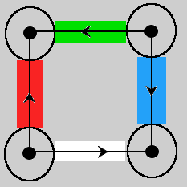
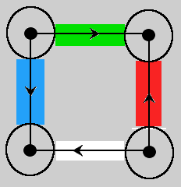
CCC codon - gluon
gluon anti-gluon

Slide 13
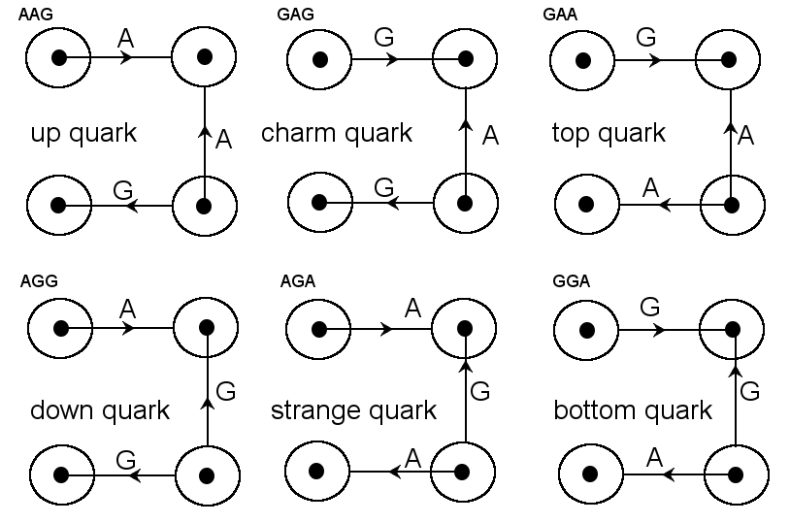
Quarks

Slide 14
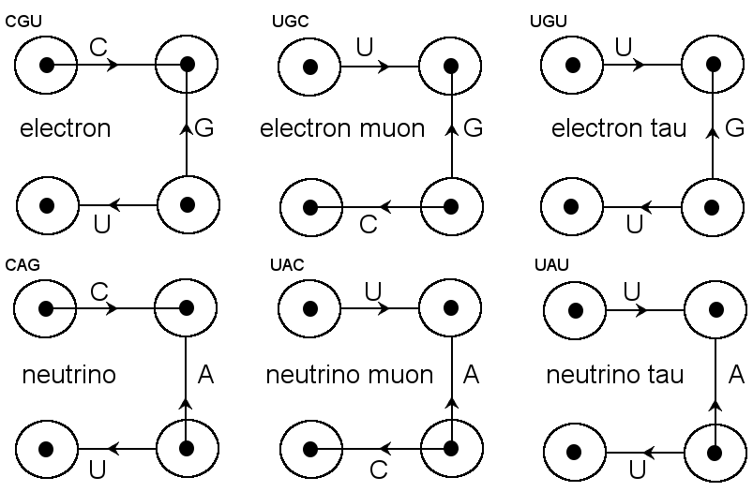
Electrons Neutrinos

Slide 15
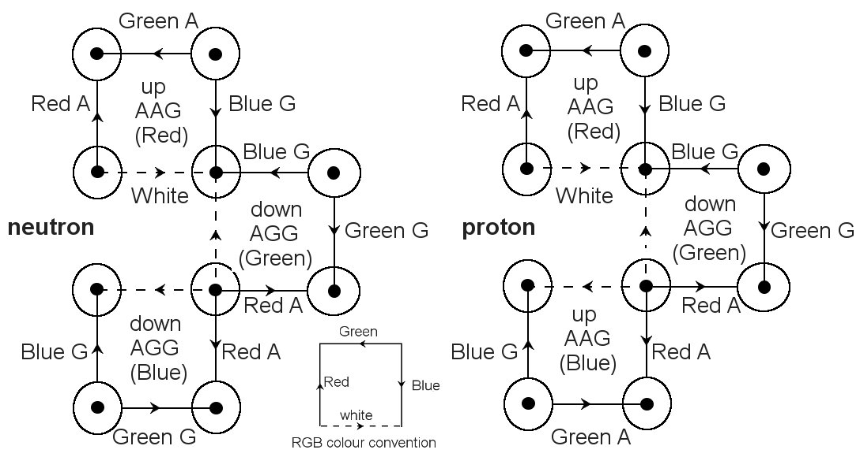

Slide 16
Gender
Entity-Property dichotomy violates FC
Solution: Properties must be considered as entities in their own right.
Gender Definition
An entity whose only specificity is that it has a property is said to be of purely feminine gender.
The entity which is that property can be said to be of purely masculine gender.
Different (by gender) but Indistinguishable.

Slide 17
Pythagorean Indeterminate Dyad
Logic: The Stoic five indemonstrables
Physics: Pneuma and the four classic elements
The 3rd indemonstrable
The first or the second but not at the same time
The first
Hence not the second

